Slide 1
DSD Final Presentation
Group 06
B10502076 電機三 金家逸
B10502010 電機三 王維勤
B10502013 電機三 林桓鈺

Slide 2
Outline
Compressed Instructions
Branch Predictor
Compressed Instructions
Multiplication Instructions
Q-sort/Conv Results
Design Improvements
Work Distribution

Slide 3
Design diagram

Slide 4









Compressed Instructions : Address alignment
PC
C
$$I_{MSB}$$
$I_{LSB}$
C
$$I$$
C
C
I-cache address
(一)
One cycle
16 bits
16 bits
16 bits
16 bits
16 bits
16 bits
16 bits
16 bits
Stall one cycle (hit)
C
$$I_{MSB}$$
C
$$I_{MSB}$$
$I_{LSB}$
C
$I_{LSB}$
C
Stall multiple cycle (miss)
(二)
(三)
$$I$$
$$I$$
C
C
C
C

Slide 5
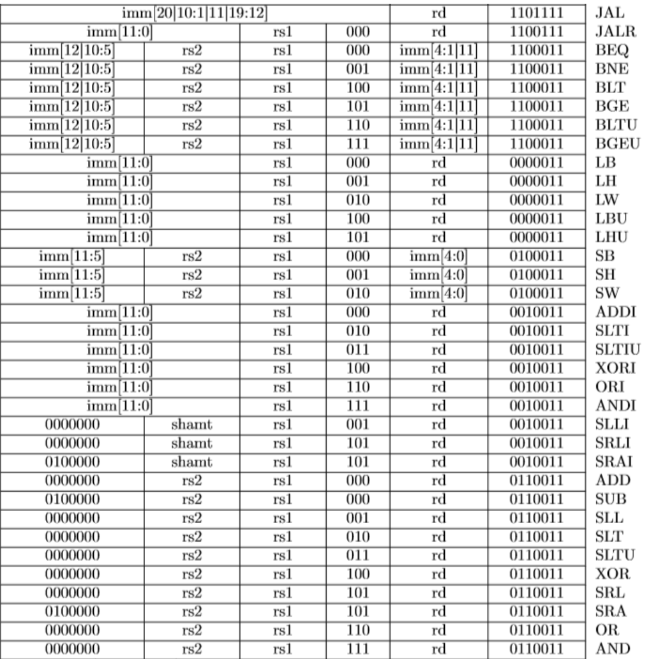
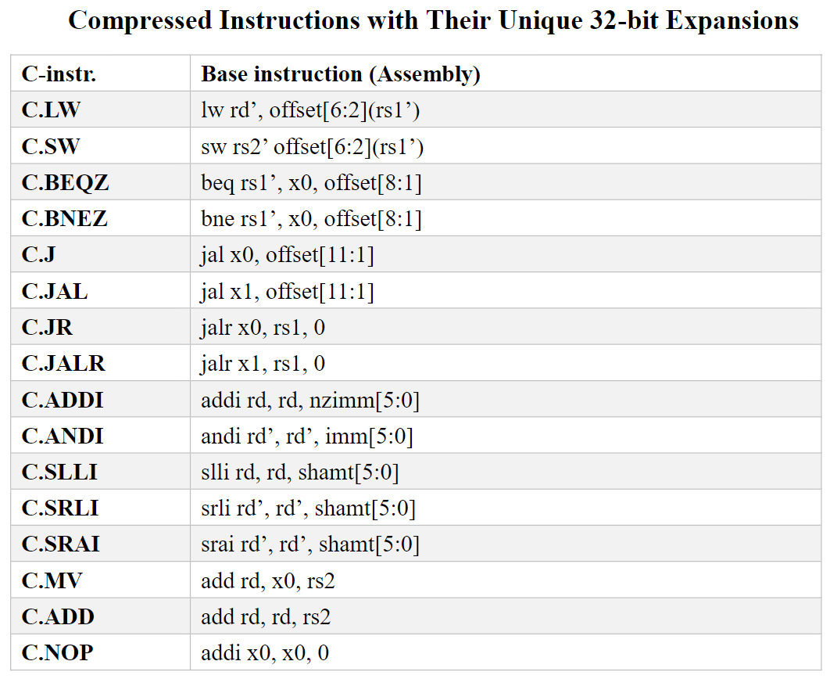
Compressed Instructions : Decompressor

Slide 6
Branch Predictor
Always Not Taken
Always Taken
2-bit Saturating Counter

Slide 7

Multiplication: Booth's Algorithm
Q | Q_-1 | Operation
0 | 0 | ARS
0 | 1 | Acc = Acc - M, ARS
1 | 0 | Acc = Acc + M, ARS
1 | 1 | ARS

Slide 8
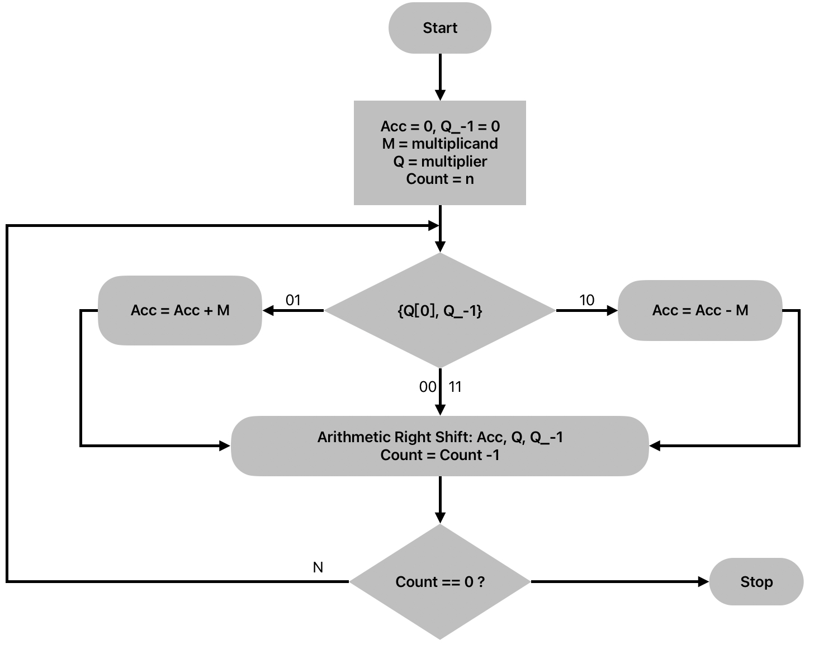
Multiplication: Booth's Algorithm

Slide 9
Multiplication: Booth's Algorithm
Perform better when the number is involved. eg: 1111111001.
Performance decreases when number is 10101010…

Slide 10

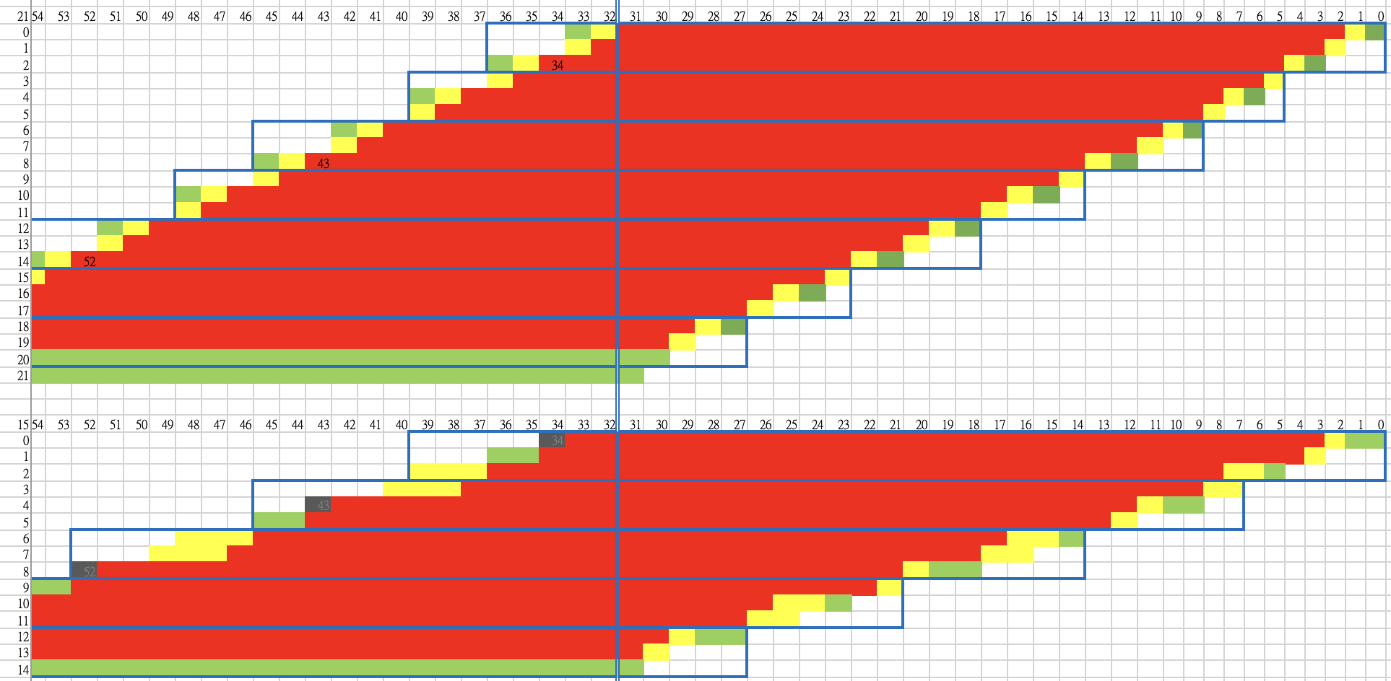
Multiplication: Wallace Tree Multiplier
Flatten the CSA multiplier
A skew tree to a balanced tree

Slide 11

Multiplication: Dadda Multiplier
16 bit
16 bit
A
$$×$$
B
16 bit
16 bit
32 bit
One stage dealy : 16*16 multiplier + 16 bit CSA
EX stage
32 bit
Pipeline cut
32 bit
MEM stage
32 bit
32 bit
Out

Slide 12
Synthesis Result
MUL | Cycle | Area | Simulation
Wallace

Slide 13
Design Improvements
Cache
Separate the design for I-cache and D-cache.
I-cache only need read operation -> small area.

Slide 14
Work Assignment
 | 金家逸 | 王維勤 | 林桓鈺
Baseline
Extension | Compress instruction Branch Predictor Optimization | Wallace Tree Multiplier Debugging Optimization | Booth Algorithm Multiplier Debugging Optimization

